Slide 1
Programming Assignment 3
TA: Yiyang Liu

Slide 2
Content
Key Concepts in Multi-Object Tracking & Instance-Level Segmentation
  Application
  Approaches
Assignment Overview
Data Preparation / Augmentation
Object Detection Model Fine-tuning
Similarity Model Training
Evaluation

Slide 3
MOTS Application
Autonomous driving: Tracking pedestrians, vehicles, and obstacles
Sports analytics: Following players and ball movement
Surveillance systems: Monitoring people and objects in security footage
Robotics: Tracking objects for manipulation or navigation
Retail analytics: Tracking customer movement in stores
Wildlife monitoring: Following animal movements in their habitats
Traffic management: Monitoring vehicle flow and pedestrian movement

Slide 4
MOTS Approaches
Detection-based tracking:
Detect objects in each frame, then associate detections across frames
Examples: SORT (Simple Online and Realtime Tracking), DeepSORT
Tracking-by-detection:
Use object detectors to propose regions of interest, then track these regions
Examples: Faster R-CNN with motion model
Joint detection and tracking:
Simultaneously detect and track objects
Examples: JDE (Joint Detection and Embedding), FairMOT

Slide 5
Off-line Tracking
Detect objects across frames in a video
Create a gallery for Re-ID
Identify a single object and assign it with the same id across frames
Output frames with bounding boxes, alongside the id

Slide 6
Assignment Overview
Goal:
Parse and prepare data. (20 points)
Tune the pre-trained model using the training data. (4-6G VRAM) (40 points)
Implement the tracker and use it with the model. (20 points)
Generate videos with masks for testing dataset. (20 points)
https://drive.google.com/file/d/1ys7PPOThBdZNKQ4PWQSVL4o2TN0vCB1e/view?usp=sharing

Slide 7
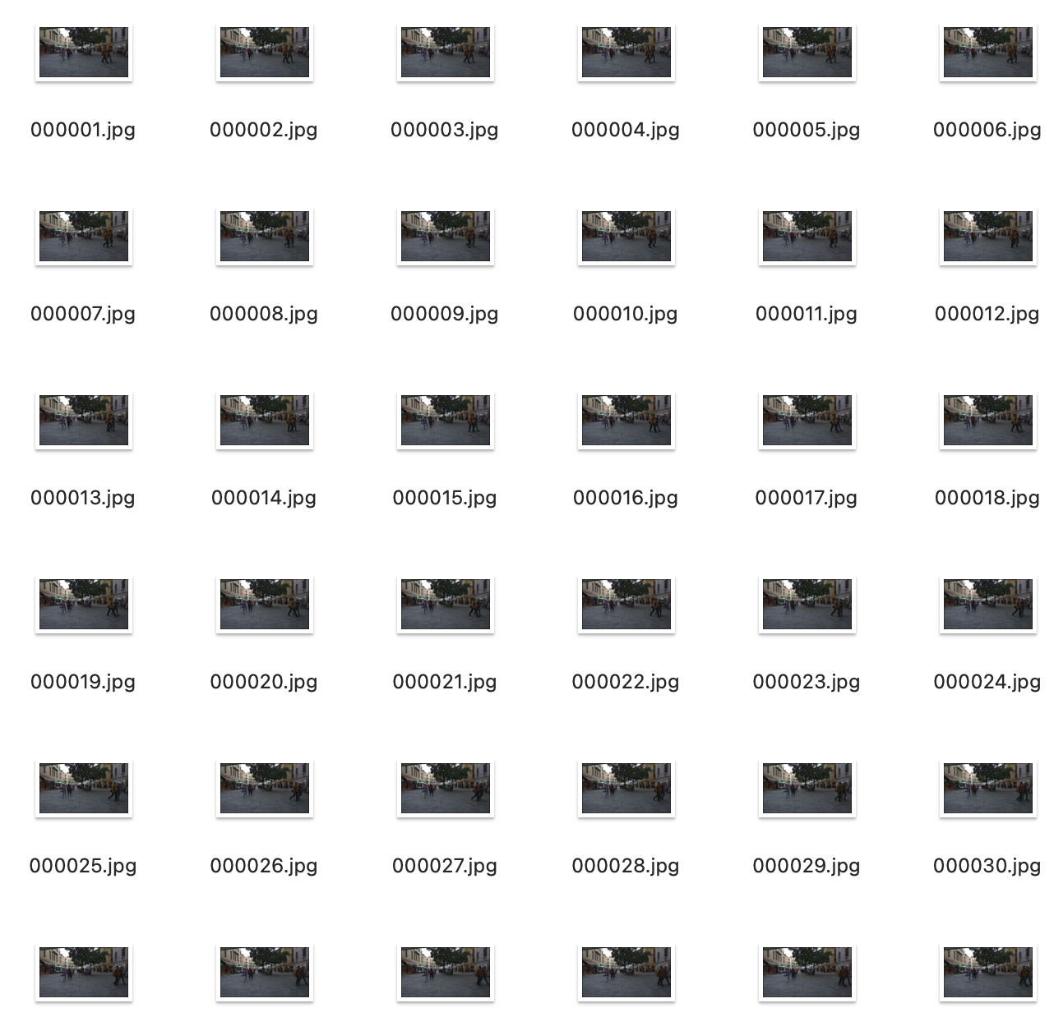
Data Preparation
Training dataset (MOTS):
1 2014 2 1080 1920 dV^Y19ZQ15M3N2N2VoNA[P1f1XO4K7`POmMmn0`2N2M3M3M300O1OTO_QOdN`n0Z2000000100L3I9bMPQOi1co0@a0E:J6L5M3M2M7JcQid0
Which means:
time frame 1
object id 2014
class id 2 (human)
image height 1080
image width 1920
rle dV^... (info of bounding boxes)

Slide 8
Data Preparation
Parse the ground truth:
import numpy as np
def decode_rle(encoded_mask, height, width):
pass
return decoded_mask
def parse_gt_file(file_path):
data = []
with open(file_path, 'r') as f:
pass
return data

Slide 9
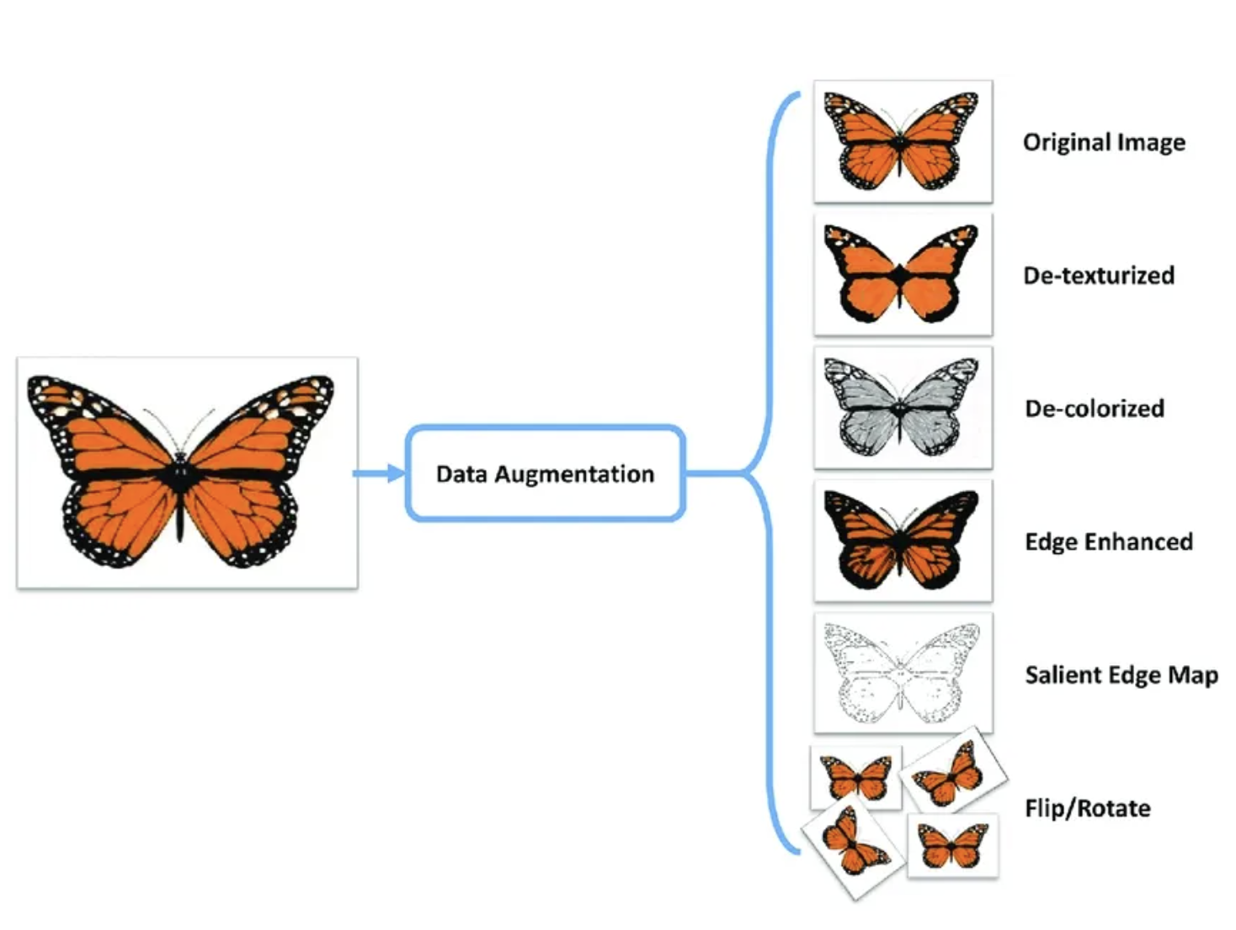
Data Augmentation
Data augmentation is the process of artificially generating new data from existing data, primarily to train new machine learning (ML) models.
Data augmentation artificially increases the dataset by making small changes to the original data.

Slide 10
Data Augmentation
from torchvision import transforms
color_aug = transforms.Compose([
transforms.ColorJitter(brightness=0.5, contrast=0.5, saturation=0.5),
transforms.GaussianBlur(kernel_size=(5, 9), sigma=(0.1, 5)),
])
augmented_image = color_aug(original_image)

Slide 11
Model
Since it requires enormous training data and computational resources to fully train a model from scratch to perform well on MOTS task, in this assignment, you are highly encouraged to load pre-trained models from torchvision and fine-tune it on the provided training dataset.
Fast R-CNN / Faster R-CNN: Used for object detection (bounding box regression and classification)
Mask R-CNN: Used for instance segmentation (pixel-wise mask prediction)

Slide 12
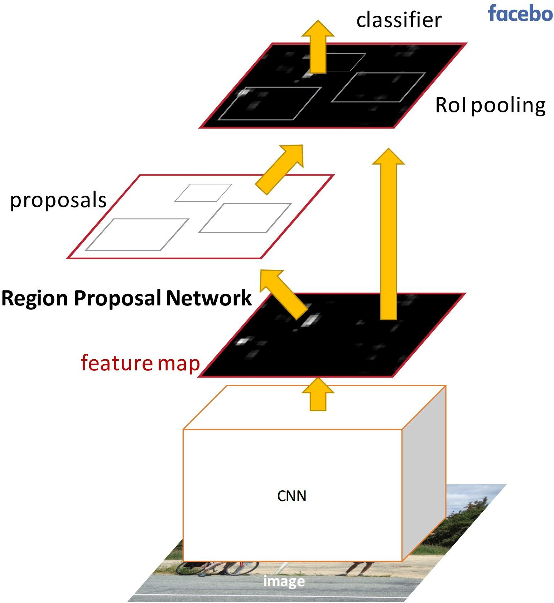
Faster R-CNN
Solution: Have the proposal generation integrated with the rest of the pipeline
Region Proposal Network (RPN) trained to produce region proposals directly.
After RPN, everything is like Fast R-CNN
Ren et al, “Faster R-CNN: Towards Real-Time Object Detection with Region Proposal Networks”, NIPS 2015

Slide 13
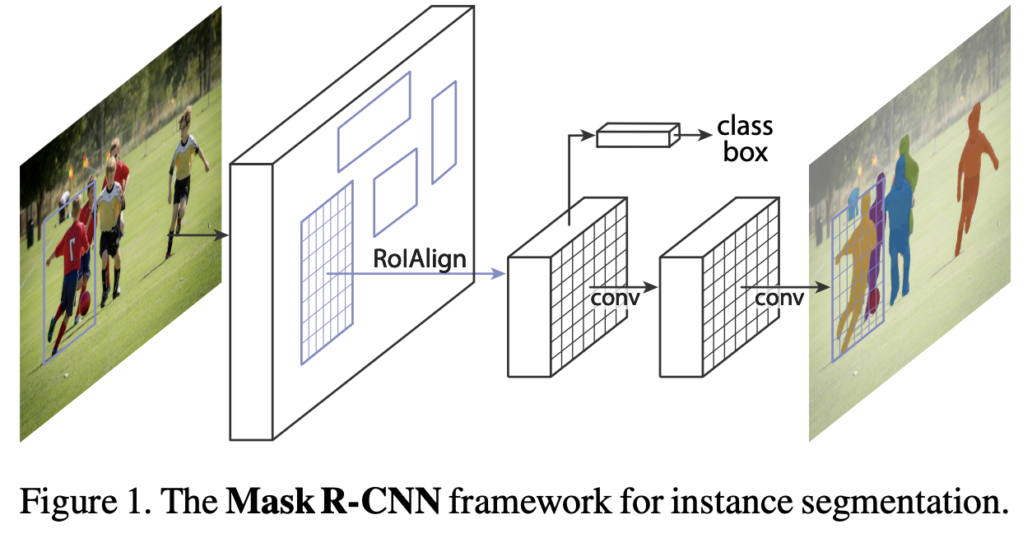
Mask R-CNN (based on Fast R-CNN)

Slide 14
Faster R-CNN
Since we will have limited amount of data to fully train a model from scratch, it’s a good approach to do few-shot fine-tuning which is a form of transfer learning.
Transfer learning is a machine learning technique in which knowledge gained through one task or dataset is used to improve model performance on another related task and/or different dataset.
Few-shot fine-tuning is to only tune a small portion of overall parameters in a large model.

Slide 15
Faster R-CNN
Since we will have limited amount of data to fully train a model from scratch, it’s a good approach to do few-shot fine-tuning which is a form of transfer learning.
Transfer learning is a machine learning technique in which knowledge gained through one task or dataset is used to improve model performance on another related task and/or different dataset.
Few-shot fine-tuning is to only tune a small portion of overall parameters in a large model.
Together with the data augmentation, we can simply tune a pre-trained model on our own small training dataset.

Slide 16
Fine-tune a pre-trained Faster R-CNN
import torchvision
from torchvision.models.detection import fasterrcnn_resnet50_fpn
from torchvision.models.detection.faster_rcnn import FastRCNNPredictor
# Freeze backbone layers
for param in model.backbone.parameters():
param.requires_grad = False
# Only fine-tune the heads for classification and mask prediction
params_to_optimize = [p for p in model.parameters() if p.requires_grad]

Slide 17
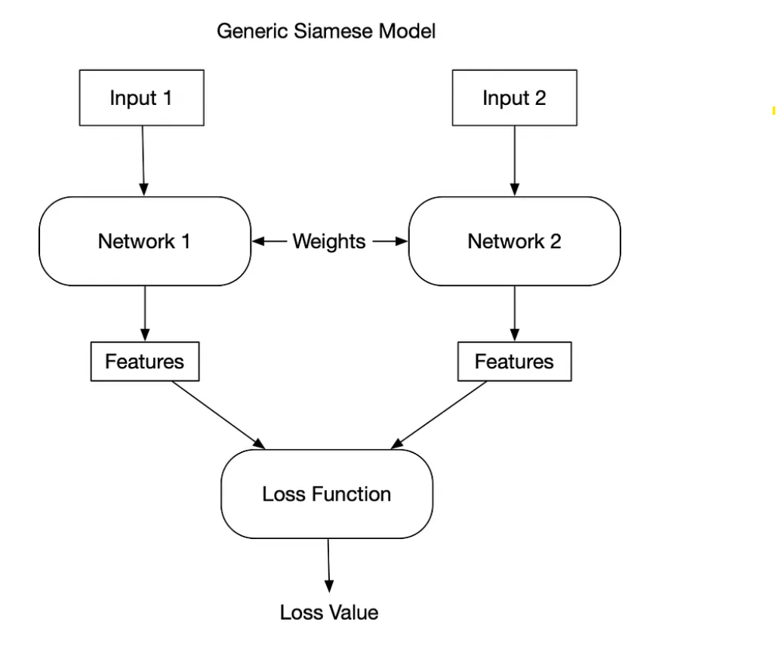
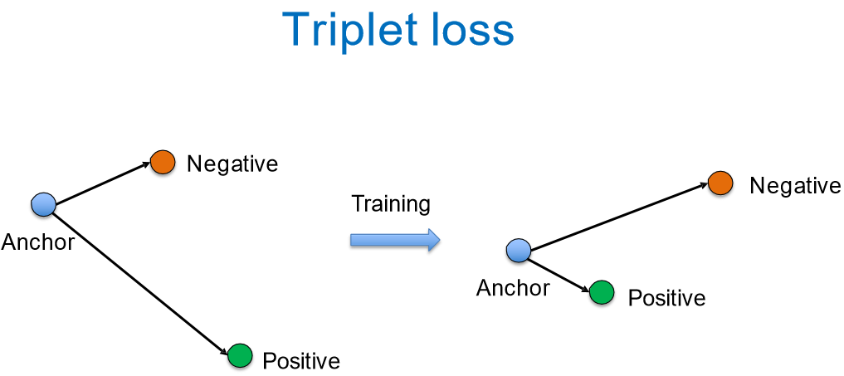
Tracker (Similarity Model)

Slide 18
Tracker (Similarity Model)
import torch
import torch.nn as nn
import torch.nn.functional as F
class Siamese_Network(nn.Module):
def __init__(self):
super(Siamese_Network, self).__init__()
# CNN layers for feature extraction
self.conv1 = nn.Conv2d(1, 64, kernel_size=3)
self.conv2 = nn.Conv2d(64, 128, kernel_size=3)
self.conv3 = nn.Conv2d(128, 128, kernel_size=3)
self.fc1 = nn.Linear(128 * 22 * 22, 256)
self.fc2 = nn.Linear(256, 256)
def forward_one(self, x):
x = F.relu(F.max_pool2d(self.conv1(x), 2))
x = F.relu(F.max_pool2d(self.conv2(x), 2))
x = F.relu(self.conv3(x))
x = x.view(-1, 128 * 22 * 22)
x = F.relu(self.fc1(x))
x = self.fc2(x)
return x
def forward(self, input1, input2):
output1 = self.forward_one(input1)
output2 = self.forward_one(input2)
return output1, output2

Slide 19
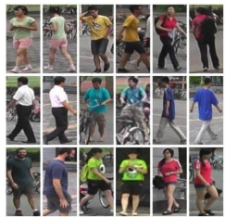
Tracker (Similarity Model)
Market-1501 Dataset
Contrastive loss
L(A, B) = y*||f (A) - f (B)||^2 + (1 – y*)max(0, m2 - ||f (A) - f (B)||^2)

Slide 20
Implementation Pipeline
Data processing(decode gt (rle)) &
Data augmentation
Faster R-CNN
Object Detection and bounding box segmentation
Faster R-CNN few-shot fine-tuning
Train the Siamese Network for Re-ID
Re-ID
Tracking objects across frames
Perform Detection and Re-ID for tracking

Slide 21
Evaluation
Present your design, implementation details, challenges encountered and a result video in class.
Rubric:
A: Perfect tracking and bounding box across frames without missing the object
B: Could track an object across several frames but not all frames
C: At least could detect the targeted object and assign a bounding box to it

Slide 22
Submission
Due day Nov 7th (3 weeks)
All of your source code (do not include any model weights)
A tracking video of a single target pedestrian on MOT16-01 (video or link)
A report that contains:
  System Design (tracking pipeline)
  Implementation Details (what kind of models you are using, how you trained it)
  Challenges encountered (how you solved them)
  A screenshot of your result video

